Slide 1
SINKHOLES
GROUP 5

Slide 2
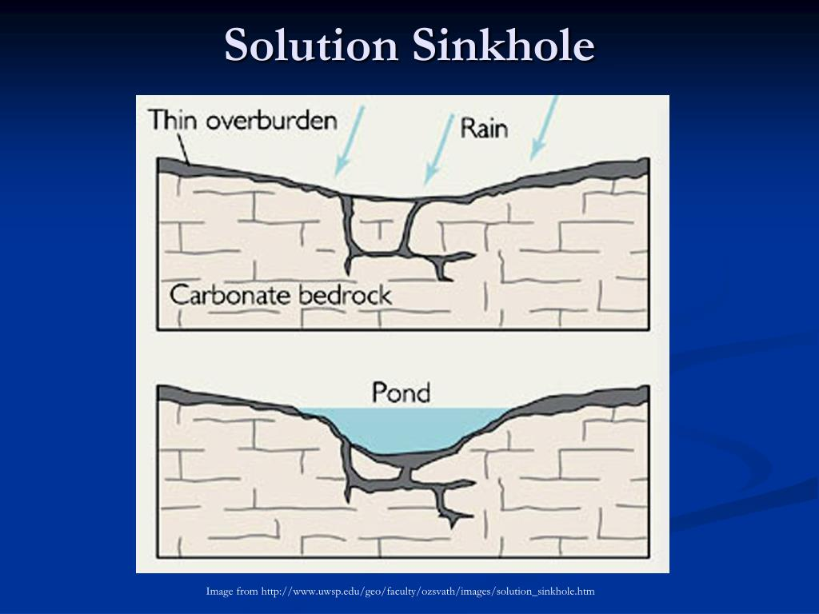
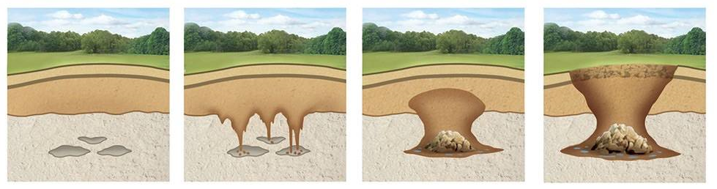
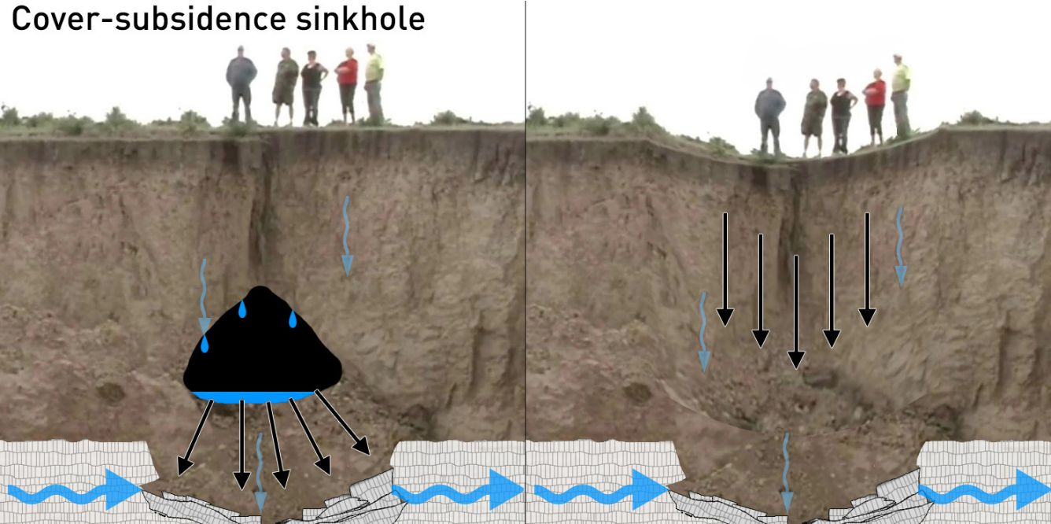
What is a Sinkhole?
A sinkhole is a depression in the ground that has no natural external surface drainage (all of the water stays inside the sinkhole and typically drains the surface).
A depression or a hole in the ground caused by a collapse of the surface layer.
Also known as a cenote, sink, swallet, swallow hole, or doline.
Three types of Sinkholes:
Solution sinkholes
common in areas where there is very thin soil cover
water erodes the area, gradually creating a bowl-shaped depression
Cover-collapse sinkholes
develop abruptly in a matter of hours and cause catastrophic damages
water erodes away the cover sediments at the bottom, causing the sediments to collapse
Cover-subsidence sinkholes
formed over a long period of time
usually happens when sand mostly covers the bedrock
Sinkholes have dramatic effects, especially in urban areas. It can contaminate water resources and swallow up multiple establishments.
It is hard to predict where and when sinkholes will occur but the Lake County Florida Department of Public Works provided some warning signs:
Holes or cracks in the ground
Sagging fence posts or trees
Newly exposed areas at the bottom of fence posts, etc.
Cracks in the foundation of a building
Other signs of shifting ground
Cloudy water pumped from a previously clear source
Standing pools of rainwater in unusual places

Slide 3
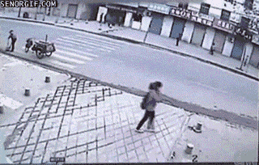
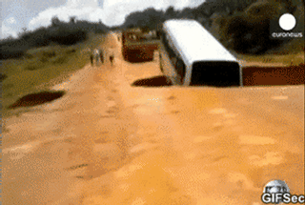
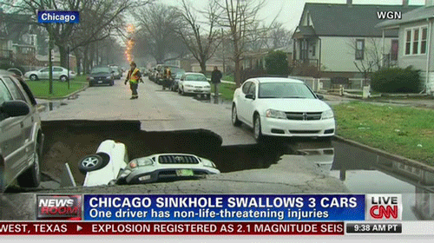

Slide 4
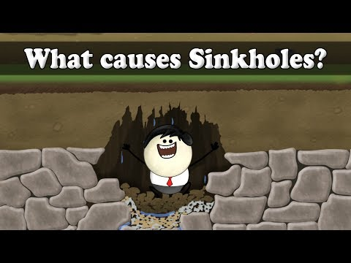

Slide 5

Before
Before
Before purchasing a land or house, do research first if the area is prone to the occurrence of sinkholes.
Practice bringing a whistle every day as this can serve as your signaling device in case of being trapped in sinkholes.
If you are already living in an area where there is frequent occurrence of sinkholes, consider leaving the area or moving to a safer place.

Slide 6
During
Don’t get too close, watch out for surface cracks and stay back.
If the hole is very large, and a risk to others, contact local police or emergency responders.
Keep children away as much as possible.
Notify all local occupants.
Notify the local water management district.
Mark the hole for safety and to restrict access. (Use posts with caution tapes or ropes)
Place a piece of plywood on smaller holes.
Take photographs for documentation, but don’t get too close.
Do not allow unauthorized or inexperienced persons to investigate the sinkhole.

Slide 7
After
If you were caught in a sinkhole and you were able to escape it, check yourself for injuries and immediately seek help and report what happened to the authorities.
If you discover a sinkhole, report it immediately to the authorities.

